Slide 1
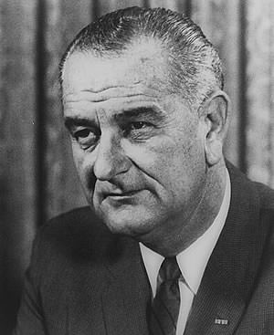
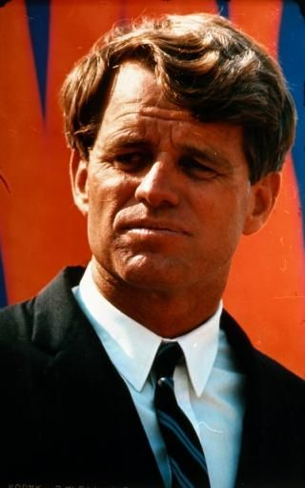
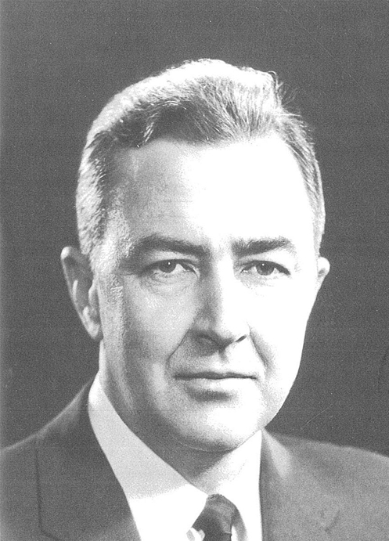
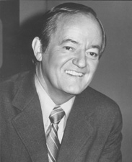
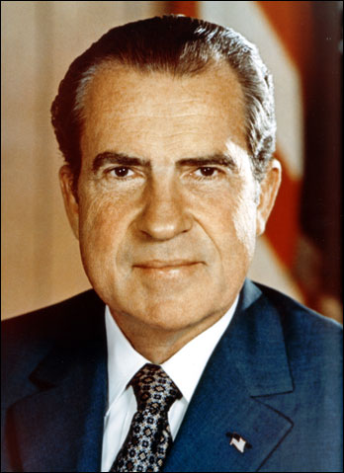
The 1968 Presidential Election

Slide 2
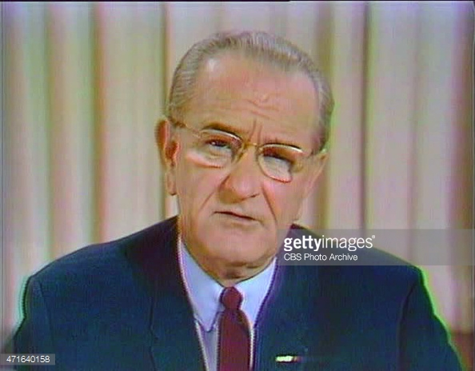
Lyndon B. Johnson (D)
Became president after the assassination of President Kennedy (November 1963)
Continued programs started under Kennedy
War on Poverty
Civil Rights
Peace Corps
Started Vietnam war in 1964-1965.
By 1968 nearly 58,000 U.S. soldiers had died
Over 500,000 U.S. soldiers are in Vietnam
March 31, 1968- Announces that he will not run for re-election in 1968

Slide 3
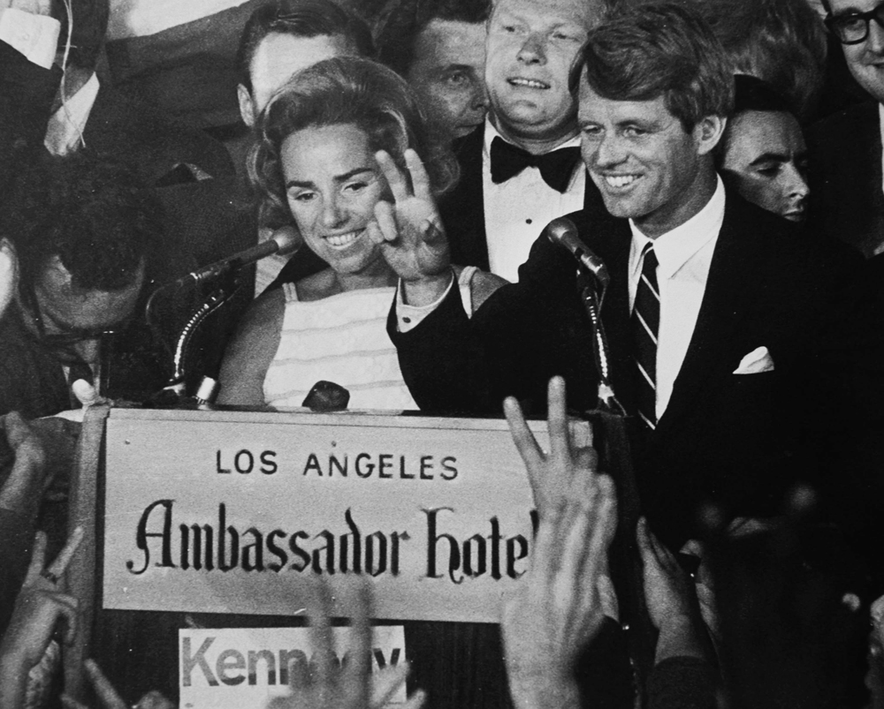
Robert Kennedy (D)
Was attorney general under his brother, President John F. Kennedy (1961-1964)
Left Johnson administration and won senate seat from New York.
Announced his candidacy March 16, 1968.
Wins majority of primaries, and is assassinated after winning the California Primary.
Leaves Democratic candidacy wide open.

Slide 4
Hubert Humphrey (D)
Senator from Minnesota.
One of the most liberal senators, and big proponent of Civil Rights, and ending the Vietnam war.
Became Vice President under Lyndon Johnson (1964-1969)
Announces candidacy on April 7, 1968.
The democratic convention is destroyed in shambles. Protests from anti-war and civil rights make the convection look bad.

Slide 5
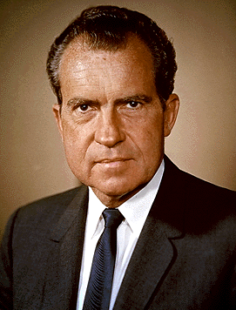
Richard Nixon
Was vice President under Dwight Eisenhower (1953-1961).
Lost first bid for the Presidency in 1960 to John F. Kennedy
Lost election for Governorship in 1962.
Announces candidacy February 1, 1968.
Republican Convection is peaceful and stand behind Nixon.
Nixon is seen as unbeatable.

Slide 6
1968 Election
One of the closest elections in U.S. history
Hubert Humphrey: 31,127,839
Richard Nixon: 31,783,783
Nixon wins and ushers in a new era of politics.
First republican president since 1961.
How does Nixon change the course of America in foreign policy and domestic policy according to his acceptance speech?

